Slide 1
Lung inflation
STUDENT’S NAME
INSTITUTIONAL AFFILIATIONS

Slide 2
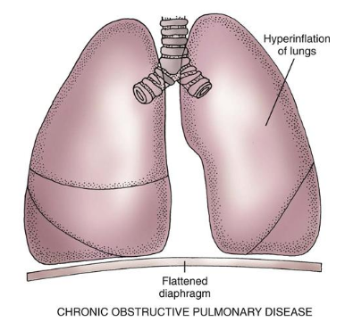
Description of lung inflation
Source: https://elink.io/p/9c6dc60
Lung inflation
Lung inflation is also known as hyperinflation
Is described as a severe increase volume of the lung
It considered as End -respiratory lung volume.
Occurs due to prolonged lung emptying rate with a shortened expiratory time inhalation(Kacmarek, Stoller, and Heuer, 241).
lung inflation is associated with obstructive airway disease
Notes:
This slide offers a description of lung inflation
Lung inflation is also known as hyperinflation and is described as a severe increase volume of the lung which is mostly considered as End -respiratory lung volume. It mostly happens due to prolonged lung emptying rate with a shortened expiratory time which results from increased ventilation frequency leading to decreased respiratory frequency. Most importantly, lung inflation is associated with obstructive airway disease that affects airflow where increased volume of lungs that prevent airflow in the body.

Slide 3
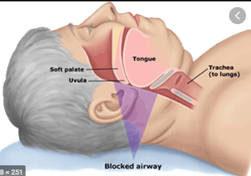
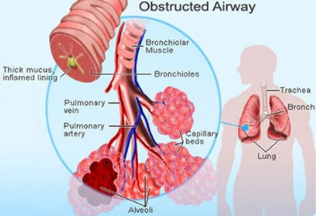
What causes lung inflation
Source :https://elink.io/p/9c6dc60 Pictures
Causes of lung inflation
Caused by airways blockage
Can occur when air is trapped within the airway.
The blockage of airways compromises the air sacs which leads to air retention by lungs.
The obstructive lung disease patients experience difficulty in inspiring
With blocked airways, the air can’t get in their breathing system inhalation(Kacmarek, Stoller, and Heuer, 241).
Notes:
This slide describe what causes lung inflation in patients
It happens when the airways are blocked or when the air is trapped within the airway. The blockage of airways compromises the air sacs which leads to air retention by lungs. The obstructive lung disease patients experience difficulty in inspiring and mostly the air can’t get in their breathing system because of the blockage of the airways hence experiences breathlessness.

Slide 4
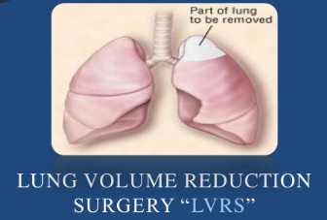
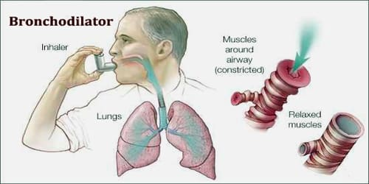
How to control lung inflation
Controlling lung inflation
Sources: https://elink.io/p/9c6dc60
Lung inflation can be controlled by surgeries for lungs reduction
The application of bronchodilators that helps in decreasing lung unit abnormality also can help in controlling it
The deflated lungs improve lungs emptying leading
Lungs emptying controls normal time constant making patients achieve the needed ventilation.
if the lungs are deflated, patients experience low operating volume of lungs with reduced oxygen of inhalation(Kacmarek, Stoller, and Heuer, 241).
Notes:
Now let see how lung inflation can be controlled
This condition can be controlled by surgeries for lungs reduction and application of bronchodilators that helps in decreasing lung unit abnormality while at the same time deflating the lungs. The deflated lungs therefore improve lungs emptying leading to normal time constant where patients achieve the needed ventilation. Mostly, if the lungs are deflated, patients experience low operating volume of lungs with reduced oxygen of inhalation.

Slide 5
Work cited
Kacmarek, Robert M., James K. Stoller, and Al Heuer. Egan's Fundamentals of Respiratory Care E-Book. Elsevier Health Sciences, 2019.

